Slide 1
Stable and Unstable Sorting Algorithm

Slide 2
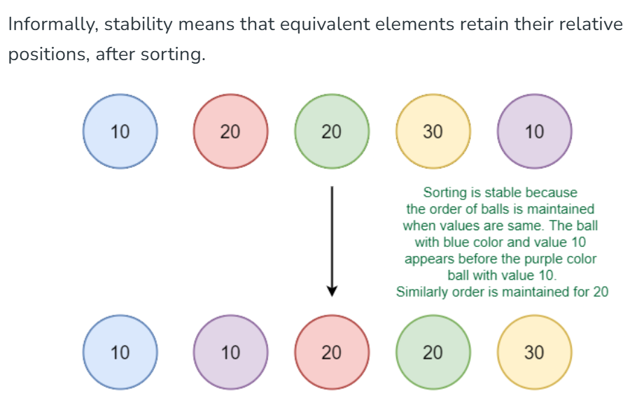
A sorting algorithm is said to be stable if two objects with equal keys appear in the same order in sorted output as they appear in the input data set.
Soucre: Stable and Unstable Sorting Algorithms - GeeksforGeeks

Slide 3
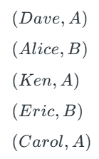
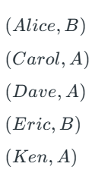
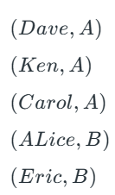
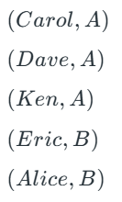
Consider the following dataset of Student Names and their respective class sections.
Sort according to Name. Resulting data is not grouped according to section
Sort again section wise. This will sort according section but not according to name
In the name-sorted dataset, the tuple (Alice, B) was before (Eric, B) , but since the sorting algorithm is not stable, the relative order is lost. If on the other hand, we used a stable sorting algorithm, the result would be:

Slide 4
Stable sorting algorithms: Bubble sort, Insertion sort, Merge sort, counting (rank sort)
Unstable sorting algorithms: Selection sort, Quick sort and Heap sort.
In general, any comparison-based sorting algorithm which is not stable by nature can be modified to be stable by changing the key comparison operation so that the comparison of two keys considers position as a factor for objects with equal keys. Selection sort can be modified as stable
When equal elements are indistinguishable, such as with integers, or more generally, any data where the entire element is the key, stability is not an issue. Stability is also not an issue if all keys are different.

